Slide 1

May 2018
Bangalore
Writing Functions in R
May 2018
Bangalore

Slide 2
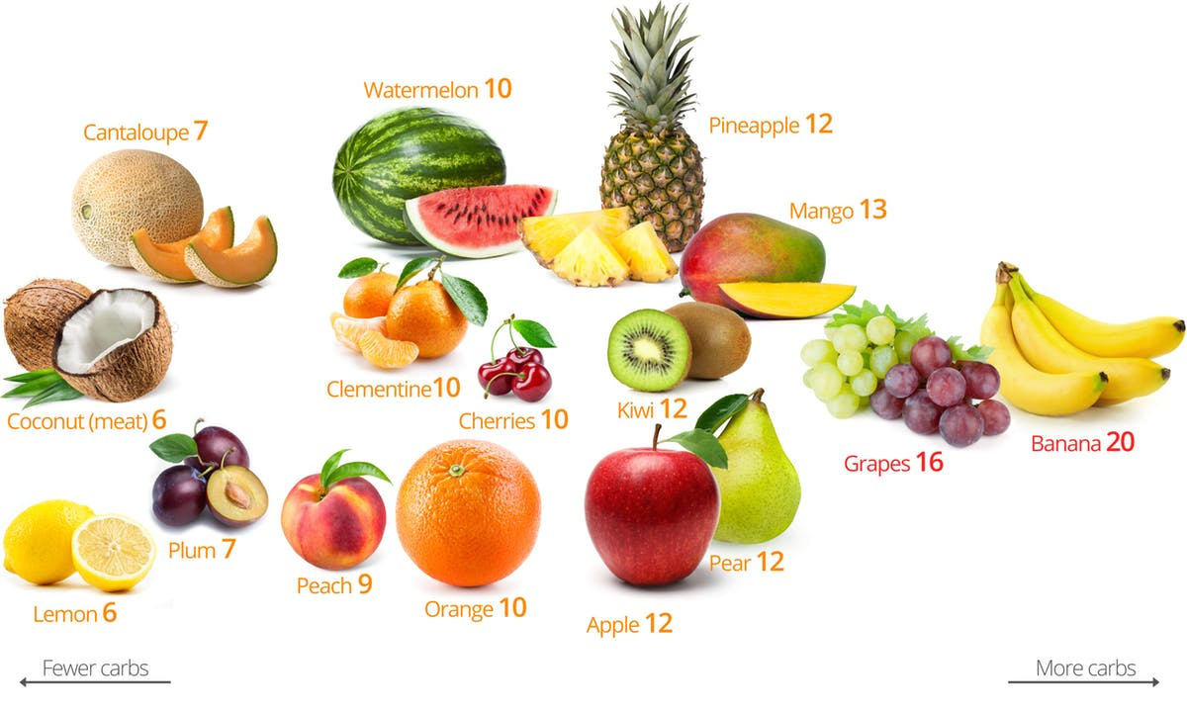
Suppose you want to taste all
the fruits but don’t have time.
What you will do to have all the fruits??????

Slide 3
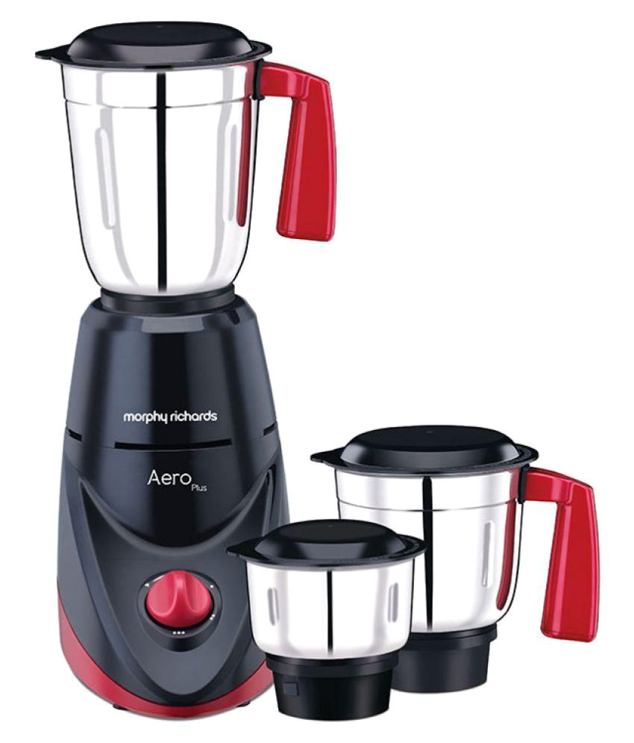
The best possible solution is to use a Mixer or Grinder.

Slide 4
Function
What is a function?
A function is a set of statements organized together to perform a specific task. R has a large number of in-built functions and the user can create their own functions.
In R, a function is an object so the R interpreter is able to pass control to the function, along with arguments that may be necessary for the function to accomplish the actions.
The function in turn performs its task and returns control to the interpreter as well as any result which may be stored in other objects.

Slide 5
Function
What is a function?
An R function is created by using the keyword function. The basic syntax of an R function definition is as follows −
function_name <- function(arg_1, arg_2, ...) {
Function body
}
The different parts of a function are −
Function Name − This is the actual name of the function. It is stored in R environment as an object with this name.
Arguments − An argument is a placeholder. When a function is invoked, you pass a value to the argument. Arguments are optional; that is, a function may contain no arguments. Also arguments can have default values.
Function Body − The function body contains a collection of statements that defines what the function does.
Return Value − The return value of a function is the last expression in the function body to be evaluated.
R has many in-built functions which can be directly called in the program without defining them first. We can also create and use our own functions referred as user defined functions.

Slide 6
Function
Built-in Function
Simple examples of in-built functions are seq(), mean(), max(), sum(x)and paste(...) etc. They are directly called by user written programs. You can refer most widely used R functions.
# Create a sequence of numbers from 32 to 44.
print(seq(32,44))
# Find mean of numbers from 25 to 82.
print(mean(25:82))
# Find sum of numbers from 41 to 68.
print(sum(41:68))
[1] 32 33 34 35 36 37 38 39 40 41 42 43 44
[1] 53.5
[1] 1526

Slide 7
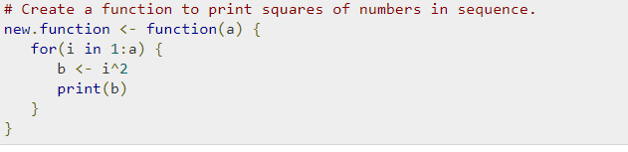
Function
User-defined Function
We can create user-defined functions in R. They are specific to what a user wants and once created they can be used like the built-in functions. Below is an example of how a function is created and used.
# Call the function new.function supplying 6 as an argument. new.function(6)

Slide 8
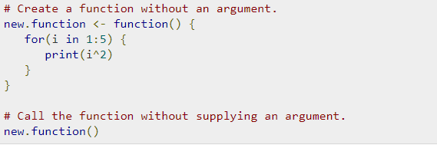
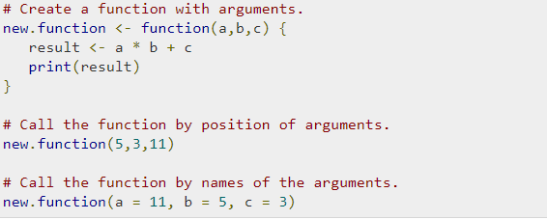
Function
Calling a Function without an Argument
Calling a Function with Argument Values (by position and by name)

Slide 9
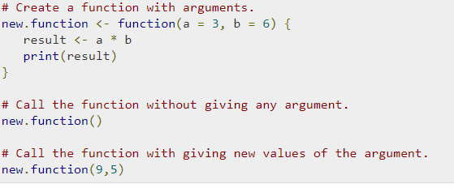
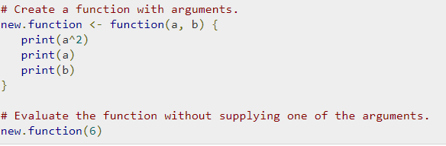
Function
Calling a Function with Default Argument
Lazy Evaluation of Function

Slide 10
Operators in R
R has many operators to carry out different mathematical and logical operations.
Operators in R can mainly be classified into the following categories
Type of operators in R
Arithmetic Operators
Relational Operators
Logical Operators
Assignment Operators

Slide 11
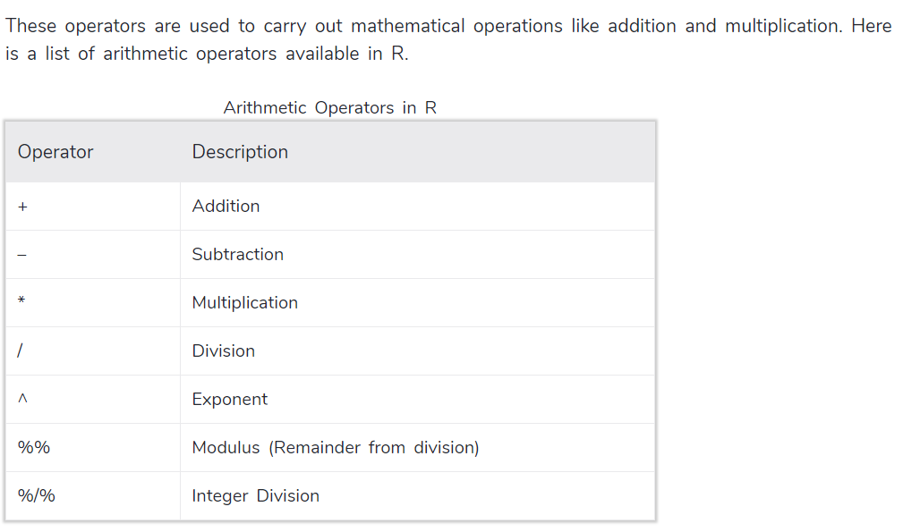
Arithmetic Operators in R

Slide 12
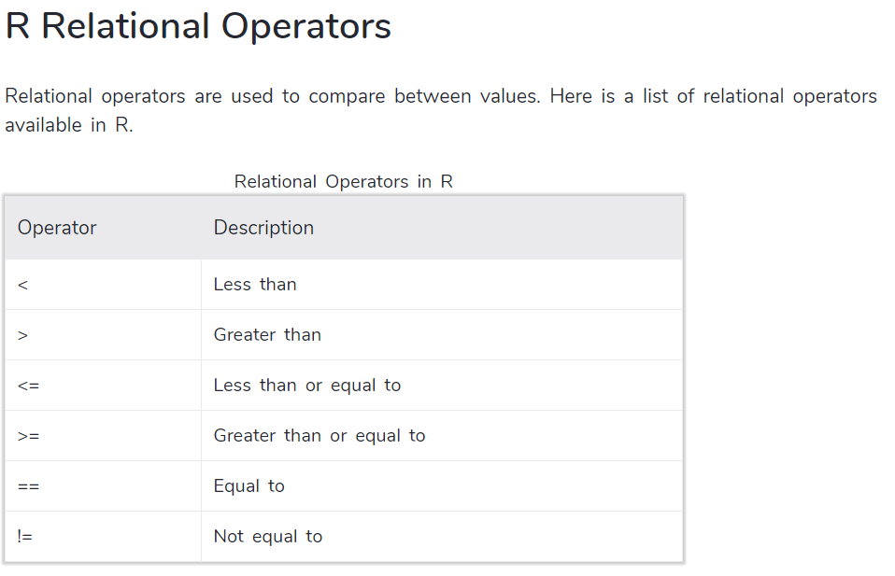
Relational Operators in R

Slide 13
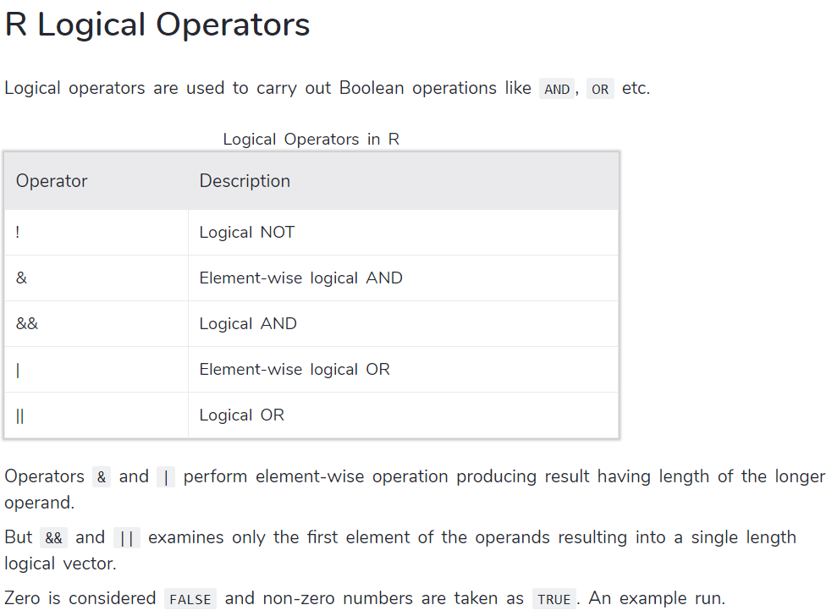
Logical Operators in R

Slide 14
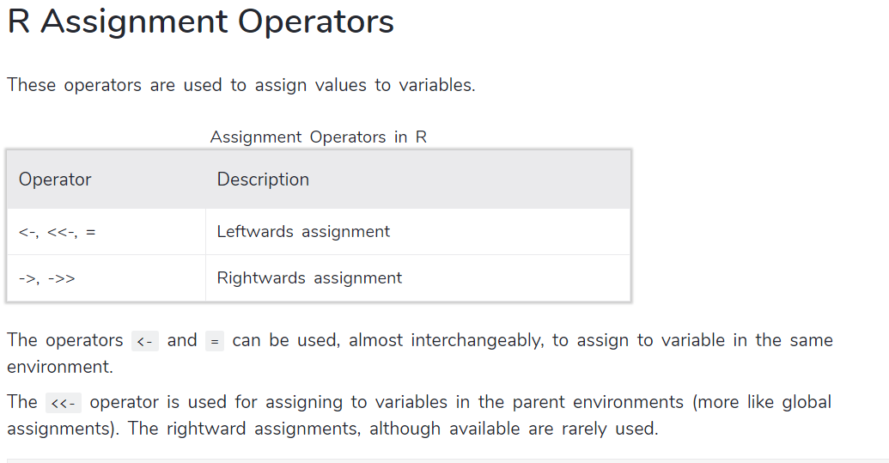
Assignment Operators in R

Slide 15
Apply Family
The apply family pertains to the R base package, and is populated with functions to manipulate slices of data from matrices, arrays, lists and dataframes in a repetitive way. These functions allow crossing the data in a number of ways and avoid explicit use of loop constructs. They act on an input list, matrix or array, and apply a named function with one or several optional arguments.
The called function could be:
an aggregating function, like for example the mean, or the sum (that return a number or scalar);
other transforming or sub-setting functions;
and other vectorized functions, which return more complex structures like list, vectors, matrices and arrays.
The apply functions form the basis of more complex combinations and helps to perform operations with very few lines of code. The family comprises: apply, lapply , sapply, vapply, mapply, rapply, and tapply

Slide 16
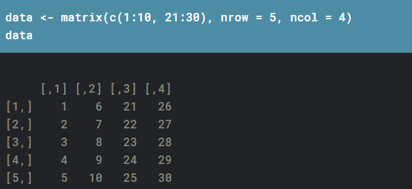
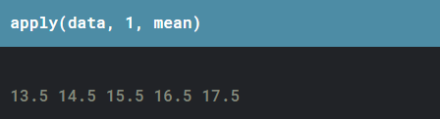
Apply Family
apply():
Now we can use the apply function to find the mean of each row as follows:
The second parameter is the dimension. 1 signifies rows and 2 signifies columns. If you want both, you can use c(1, 2).

Slide 17
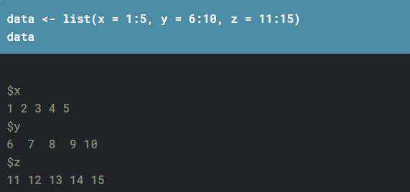
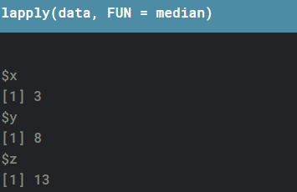
Apply Family
Lapply
lapply is similar to apply, but it takes a list as an input, and returns a list as the output. Let’s create a list
The second parameter is the dimension. 1 signifies rows and 2 signifies columns. If you want both, you can use c(1, 2).

Slide 18
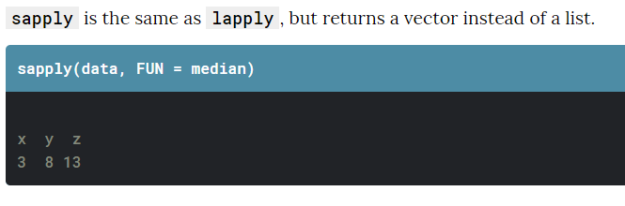
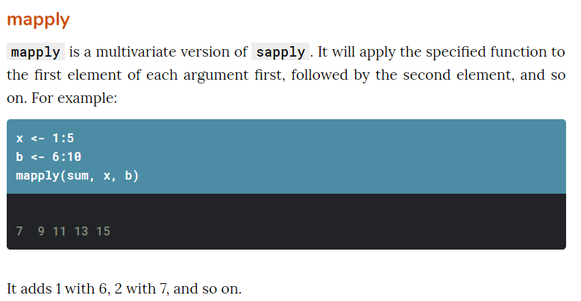
Apply Family
Sapply

Slide 19
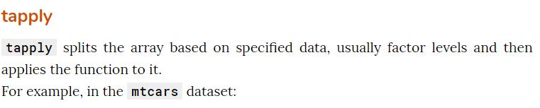
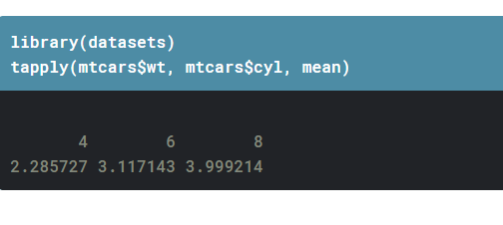

Apply Family

